Slide 1
Cloud Computing
Module 1

Slide 2
What is cloud??

Slide 3
Cloud computing is the delivery of computing services—including servers, storage, databases, networking, software, analytics, and intelligence—over the Internet (“the cloud”) to offer faster innovation, flexible resources, and economies of scale.

Slide 4
Why cloud Computing??

Slide 5
Cloud computing gives your business more flexibility. You can quickly scale resources and storage up to meet business demands without having to invest in physical infrastructure. Companies don't need to pay for or build the infrastructure needed to support their highest load levels.

Slide 6
Traditional Computing
It refers to delivery of different services on local server.
It takes place on physical hard drives and website servers.
User can access data only on system in which data is stored.
It does not require any internet connection to access data or information.
Software in purchased individually for every user and requires to be updated periodically.

Slide 7
What are the limitations of Traditional computing?
Administrative overhead
High maintenance cost
Time and Space restrictions
Limited Scalability
Remote access to system is not available

Slide 8
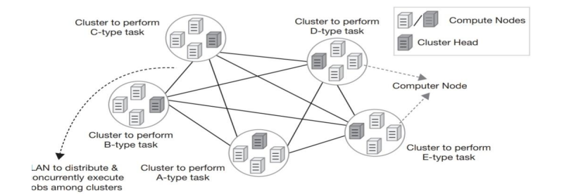
System Models for Distributed and Cloud Computing- 1. Cluster Computing
Computing clusters are made of multiple nodes (computers) connected via network which perform similar tasks.
Execution of a task can be faster as it can be distributed and executed in parallel across multiple machines inside a cluster
All the nodes of a cluster together give impression of a single system.
Each node in a simple cluster is set to perform same task or same set of tasks

Slide 9
Cont..
In each cluster, one computer is assigned the job of controlling the cluster. That particular computer (or node) is known as cluster head.
The head’s responsibility in such a simple cluster is to divide and distribute jobs among different nodes in that cluster when matching computing tasks appear.
In an actual cluster computing system, multiple clusters (built to perform different type of functionalities) are linked together through a LAN
when a particular job appears, the cluster head divides and distributes it among matching clusters (designated for those jobs) for faster execution
Computers are clustered together to achieve reliability, greater processing power and produce supercomputer like performance
In this computing model, a set of computers were reserved to handle specific type of task to make the system more reliable. If any node fails, other nodes in the cluster can handle the load
Cluster computing introduced the concept of resource pooling. The pools were made of homogeneous computing systems.

Slide 10
2. Grid Computing
In the process of finding a solution to this problem, technologists came up with an idea where each node belonging to a cluster would have same priority. It was required that all of them could perform similar functions and no particular node had to be assigned the role of ‘head’ among them. This new architecture is called a Grid.
Grid computing concept introduced the idea of decentralization of control in distributed computing environment.
Another important feature introduced by grid computing is that the computing environment could now be built with heterogeneous computing systems, that is, systems with diverse hardware configurations.
The other major challenge before setting up a large distributed computing environment is stablishing cooperation among systems of different administrative domains.
Computing grid introduced distributed computing environment, made up of heterogeneous systems which could be located at separate administrative domains.

Slide 11
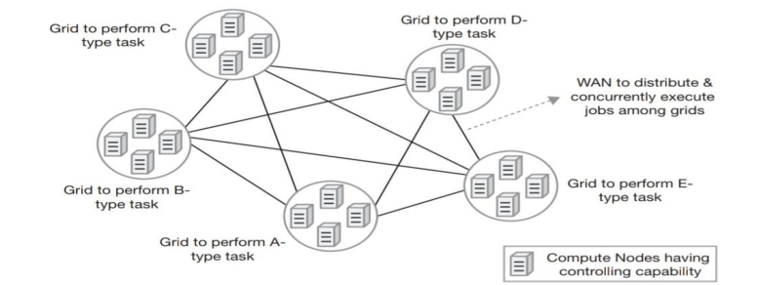
Cont…

Slide 12
With grid computing era, computing systems reached a stage where they had acquired the following important characteristics
Large scale: Grid concept promises to deal with computing resources going up to millions.
Geographical distribution: Computing resources could be located at distant places.
Heterogeneity: Computing grid could accommodate resources having different hardware characteristics and using various types of software.
Resource co-ordination: Resources in a grid could coordinate among themselves to generate aggregated computing capabilities.
Pervasive access: Resource failure could be handled by granting access to other available resources.
Unlimited resource addition (scaling): Being a distributed computing model, it allows easy growth of system capacity by adding more resources into an existing system

Slide 13
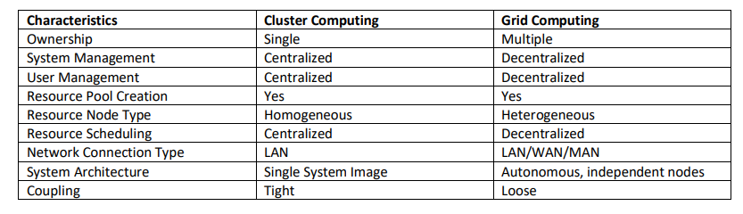
Difference between Cluster Computing and Grid Computing?

Slide 14
Utility Computing
In utility computing a service provider makes computing resources and infrastructure management available to the customer as needed & charges them for specific wage rather than flat rate.
Utility is the packaging of system resources such as computations, storage as a metered service. - Focused on on-demand computing like computing can be delivered as a utility service much like electricity.
Utility Computing is the packaging and delivery of computing resources, similar to traditional public utilities like electricity, water, or telephone. The model follows pay-per-use mode of payment and on-demand service facility.
This sort of computing enabled small business owners to afford high-performance computing facilities, which with their limited budget they could have never dreamed of using.
One important facilitator behind utility computing idea implementation was the virtualization concept of hardware resources like processor, memory, storage, and network.

Slide 15
Distributed Computing
Distributed computing is a model in which components of a software system are shared among multiple computers or nodes. Even though the software components may be spread out across multiple computers in multiple locations, they're run as one system. This is done to improve efficiency and performance.
Distributed computing can increase performance, resilience and scalability, making it a common computing model in database and application design.
Distributed computing networks can be connected as local networks or through WAN if the machines are in a different geographic location.
Processors in distributed computing systems typically run in parallel.
Cloud computing is also a specialized form of distributed computing.

Slide 16
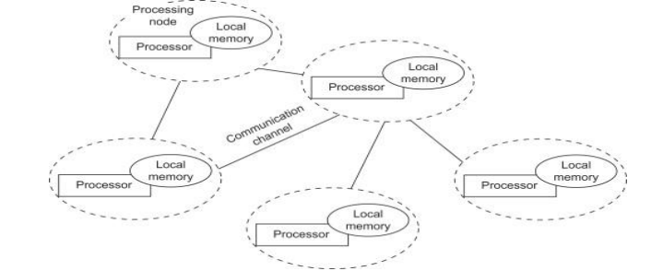

Slide 17
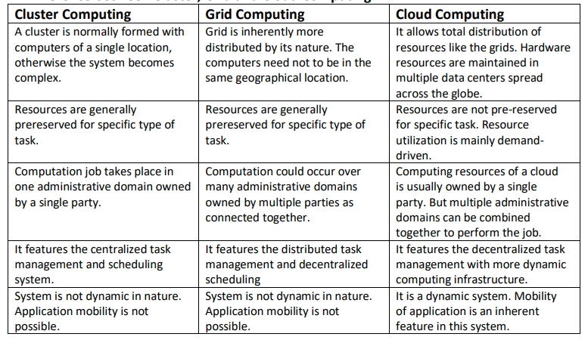

Slide 18
NIST Reference Model – Basic Terminologies and Concepts
The NIST model of cloud computing separates cloud computing in two categories. One category is based on the operational or deployment pattern of the cloud and the other one is based on the nature of service that the cloud provides.
Cloud modeling based on deployment: It focusses on the access boundary and location of the cloud establishment. The access boundary defines the purpose of using the cloud to some extent. There are four categories of cloud deployment: public cloud, private cloud, community cloud and hybrid cloud.
Cloud modeling based on service delivery: This model describes the type of computing service that is offered to users by the service provider. There are three prime categories of service delivery models, namely Infrastructure as a Service (IaaS), Platform as a Service (PaaS) and Software as a Service (SaaS)

Slide 19
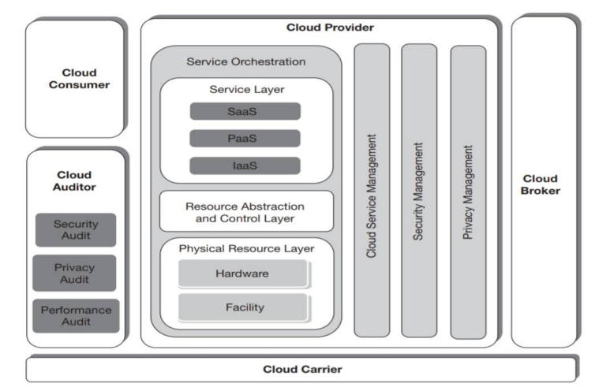
NIST model

Slide 20
Cloud Consumer: The cloud consumer is the principal stakeholder for the cloud computing service. A cloud consumer represents a person or an organization that maintains a business relationship with, and uses the service from a cloud provider. The cloud consumer uses cloud service and may be billed for the service by the provider.
Cloud Provider: A cloud provider is a person or an organization; it is the entity being responsible for making a service available to interested parties. A Cloud Provider acquires and manages the computing infrastructure required for providing the services.
Cloud Auditor: The cloud services provided by cloud provider to the cloud consumer must comply to some pre-agreed policies and regulations in terms of performance, security etc. The verification of these agreed conditions can be performed by employing a third-party auditor. The cloud auditor is a party who can conduct independent assessment of cloud services and report it accordingly.
Cloud Broker: A cloud broker is an entity that manages the use, performance, and delivery of cloud services and negotiates the relationships between cloud providers and cloud consumers. Consumers can avoid the responsibilities of complex tasks by requesting services from brokers instead of consuming services from providers directly.

Slide 21
Cloud Carrier: Cloud computing services are delivered from cloud provider to cloud consumer either directly or via some cloud broker. Cloud carrier acts as an agent in this delivery process. They are the organizations who provide the connectivity and transport facility of services through their network.
Service Management: The Service Management component of cloud provider takes care of the functions needed for the management and operation of cloud services. There are three modules of cloud service management as business support, provisioning/configuration and portability/interoperability
Security & Privacy: Security management in the NIST reference architecture refers towards developing a secure and reliable system. It means protecting the system and its information from unauthorized access. Privacy management aims to keep personal or sensitive information secret and saves them from revealing out.

Slide 22
Service Orchestration: Service orchestration refers to the ‘composition of system components to support the cloud providers’ activities in arrangement, coordination and management of computing resources in order to provide cloud services to cloud consumers.
It has 3 layers.
Service layer: Cloud provider puts interfaces that enables the service consumers to access various computing services. Thus the access interfaces for different types of cloud services (SaaS, PaaS and IaaS) are represented in this layer.
Resource Abstraction & Control layer: At this layer, the abstraction of physical resources are implemented (through the software). Access to any hardware resources goes through this layer and the layer secures the system by controlling resource allocation and access.
Physical Resource layer: The physical resource layer is the lowest layer in the stack that houses all of the physical computing resources. Hardware resources include computers (with processor and memory components), storage components (hard disks), network entities (routers, firewalls, switches, network links and interfaces) and other physical computing devices. Facilities include includes power supply, ventilation, cooling, communications and other aspects of a physical plant.

Slide 23
Cloud Deployment Models or Types of cloud
Public Cloud
Private Cloud
Community Cloud
Hybrid Cloud

Slide 24
Public Cloud
The infrastructure is made available to the general public or a large industry group and is owned by an organization selling cloud services.
The public cloud deployment model provides the widest range of access to consumers among all cloud deployments.
Anyone who subscribes it gets open access to this cloud facility. The consumer can either be an individual user or a group of people representing some organization or an enterprise.
Public cloud is also referred as external cloud as physical location-wise it remains external or off-premises and the consumers can then remotely access the service.
A public cloud is hosted and managed by some computing vendors who establishes data centers to provide the service to consumers.
Amazon Web Services, Google Cloud, Microsoft Azure and Salesforce.com are some of the popular public clouds.
Public cloud deployment promotes multi-tenancy at its highest degree. Same physical computing resource can be shared among multiple unrelated consumers. This provides major advantages as it becomes possible for a single cloud vendor to serve a large number of consumers

Slide 25
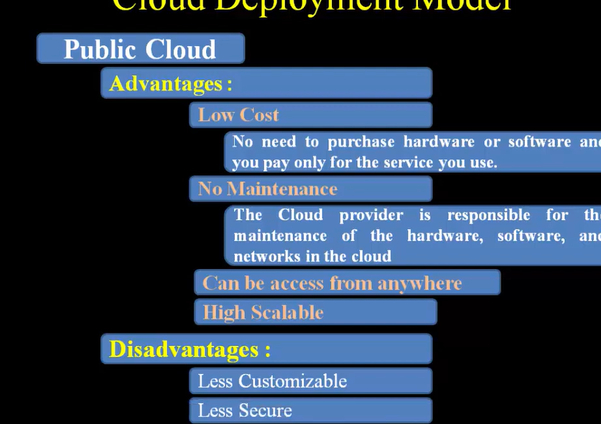

Slide 26
Private Coud
The private cloud deployment does not provide open access to all. It is mainly for organizational use and access to a private cloud deployment is restricted for general public.
Private cloud is also referred as internal cloud since it is built to serve internal purpose of the organizations.
The infrastructure is operated solely for an organization, It may be managed by the organization or a third party and may exist on or off the premises of the organization.
For high-security and critical systems, like systems of defense organizations, private cloud is the suggested approach.
While a public cloud cannot physically reside at any consumer’s location (physical boundary), private clouds may reside either inside consumer organization’s premises (on-premises) or outside (off-premises) at any neutral location.
A private cloud may be established and managed by the consumer organization itself or they (the consumer) may outsource the responsibility to some other computing vendor.

Slide 27
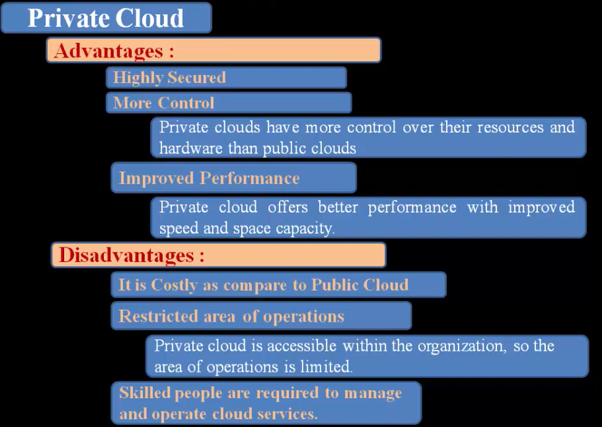

Slide 28
Community Cloud
The community cloud deployment model allows access to a number of organizations or consumers belonging to a community and the model is built to serve some common and specific purpose.
It is for the use of some community of people or organizations who share common concerns in business functionalities, security requirements etc.
Community cloud deployment can be on-premises or off-premises.
Physically it may reside on any community member’s premises or it may be located in some external location. Like private cloud, this cloud can also be governed by some participating organization(s) (of the community) or can be outsourced to some external computing vendor.
The goal of community cloud deployment is to provide the benefits of public cloud, like multi-tenancy, payper-use billing etc. to its consumers along with added level of privacy and security like the private cloud.
One familiar example of community cloud is some services launched by government of a country with the purpose of providing cloud services to national agencies. The agencies are consumers in this case belonging to a single community (the government).

Slide 29
Hybrid Cloud
A hybrid cloud is generally created by combining private or community deployment with public cloud deployment together.
This deployment model helps businesses to take advantage of private or community cloud by storing critical applications and data.
There at the same time, it provides the cost benefit by keeping shared data and applications on the public cloud.
The hybrid cloud can be formed by combining two elements from a set of five different cloud deployments as on-premises private cloud, off-premises private cloud, on-premises community cloud, off-premises community cloud and public cloud, where one among the first four deployments is combined with the last one (public cloud)

Slide 30
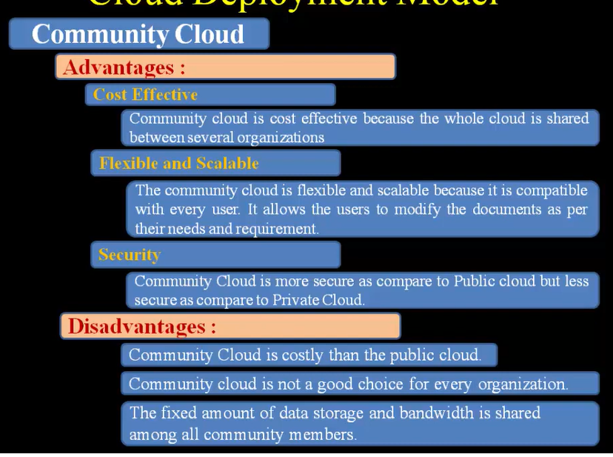

Slide 31
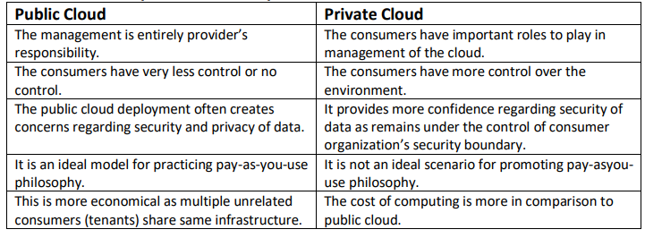
Difference between public cloud and private cloud

Slide 32
Benefits of Cloud
High Speed – Quick Deployment: The ability to spin up new cloud computing instances in a matter of seconds reshaped the agility and speed of software development. Developers can easily test new ideas and design application architecture without the dependency on on-site hardware limitations or slow procurement processes.
Efficiency and Cost Reduction: By using cloud infrastructure, you don’t have to spend huge amounts of money on purchasing and maintaining equipment. You don’t have to invest in hardware, facilities, utilities, or building out a large data center to grow your business. You do not even need large IT teams to handle your cloud data center operations, as you can enjoy the expertise of your cloud provider’s staff.
Data Security: Cloud offers many advanced security features that guarantee that data is securely stored and handled.

Slide 33
Scalability: Cloud-based solutions are ideal for businesses with growing or fluctuating bandwidth demands. If your business demands increase, you can easily increase your cloud capacity without having to invest in physical infrastructure. This scalability minimizes the risks associated with in-house operational issues and maintenance.
Unlimited Storage Capacity: Related to the scalability benefit above, the cloud has essencially unlimited capacity to store any type of data in various cloud data storage types, depending on the availability, performance and frequency the data has to be accessed.
Back-up and Restore Data: The fact that data can be stored in the cloud without capacity constrains also helps with backup and restore purposes.
Data Loss Prevention: Cloud infrastructure can also help you with loss prevention. If you upload your data to the cloud, it remains accessible for any computer with an internet connection, even if something happens to your work computer.

Slide 34
Challenges of cloud computing
Security, Privacy, and Trust: Security and privacy affect the entire cloud computing stack, since there is a massive use of third-party services and infrastructures that are used to host important data or to perform critical operations. In this scenario, the trust toward providers is fundamental to ensure the desired level of privacy for applications hosted in the cloud. Legal and regulatory issues also need attention.
Data Lock-In and Standardization: A major concern of cloud computing users is about having their data locked-in by a certain provider. Users may want to move data and applications out from a provider that does not meet their requirements. However, in their current form, cloud computing infrastructures and platforms do not employ standard methods of storing user data and applications. Consequently, they do not interoperate and user data are not portable. The answer to this concern is standardization.

Slide 35
Availability, Fault-Tolerance, and Disaster Recovery: It is expected that users will have certain expectations about the service level to be provided once their applications are moved to the cloud. These expectations include availability of the service, its overall performance, and what measures are to be taken when something goes wrong in the system or its components.
Resource Management and Energy-Efficiency: One important challenge faced by providers of cloud computing services is the efficient management of virtualized resource pools. Physical resources such as CPU cores, disk space, and network bandwidth must be sliced and shared among virtual machines running potentially heterogeneous workloads

Slide 36
Cloud services
Cloud computing delivers infrastructure, platform, and software (application) as services made available as subscription-based services in a pay-as-you-go model to consumers.
These are the three pillars on which cloud computing solutions deliver to end users.
All three models allow users to access services over the Internet, relying entirely on the infrastructures of cloud service providers.
These models are offered based on various service level agreements (SLAs) between providers and users.
SaaS is applied at the application end using special interfaces by users or clients.
At the PaaS layer, the cloud platform must perform billing services and handle job queuing, launching, and monitoring services.
At the bottom layer of the IaaS services, databases, compute instances, the file system, and storage must be provisioned to satisfy user demands.

Slide 37
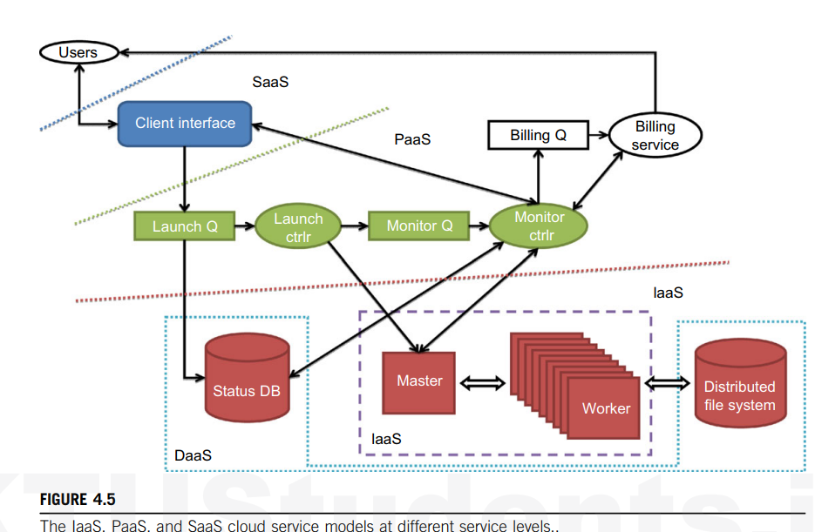
Cloud Delivery/Service Models

Slide 38
Infrastructure as a Service
This model allows users to use virtualized IT resources for computing, storage, and networking.
In short, the service is performed by rented cloud infrastructure.
The user can deploy and run his applications over his chosen OS environment.
The user does not manage or control the underlying cloud infrastructure, but has control over the OS, storage, deployed applications, and possibly select networking components.
This IaaS model encompasses storage as a service, compute instances as a service, and communication as a service.
Eg: Amazon VPC

Slide 39
Platform as a Service (PaaS)
The platform cloud is an integrated computer system consisting of both hardware and software infrastructure.
The user application can be developed on this virtualized cloud platform using some programming languages and software tools the provider supports (e.g., Java, Python, .NET).
The user does not manage the underlying cloud infrastructure.
The cloud provider supports user application development and testing on a well-defined service platform.
Eg: Google App Engine

Slide 40
Software as a Service (SaaS)
The SaaS model provides software applications as a service.
As a result, on the customer side, there is no upfront investment in servers or software licensing.
On the provider side, costs are kept rather low, compared with conventional hosting of user applications.
Customer data is stored in the cloud that is either vendor-proprietary or publicly hosted to support PaaS and IaaS.
The best examples of SaaS services include Google Gmail and docs, Microsoft SharePoint, and the CRM software from Salesforce.com.

Slide 41
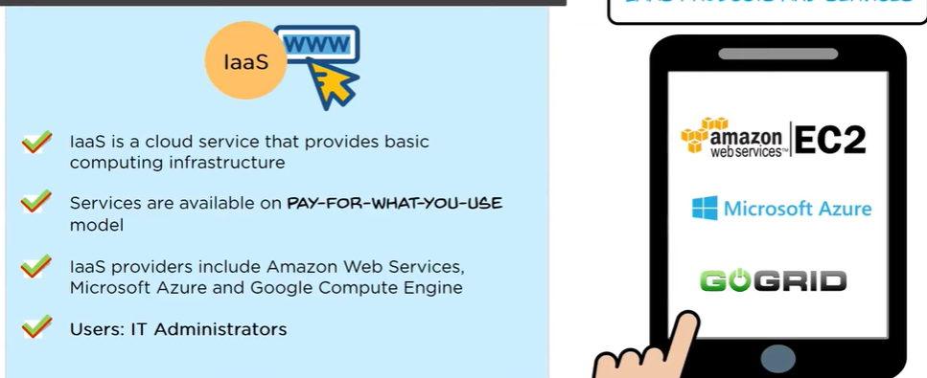
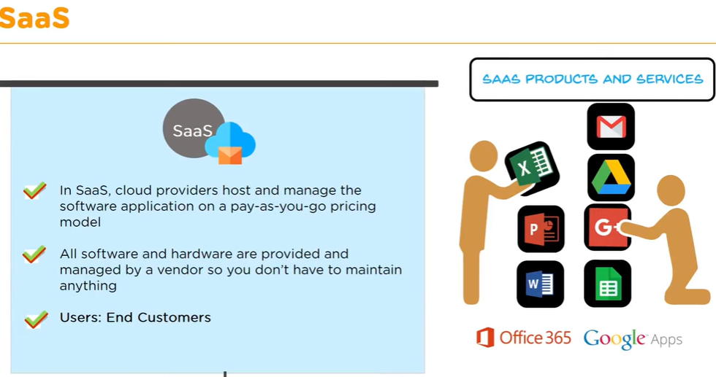
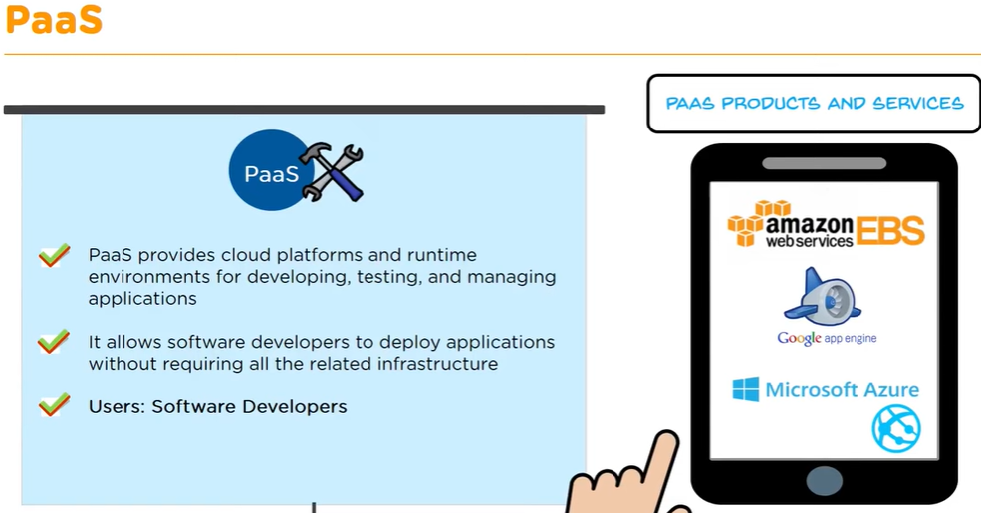

Slide 42
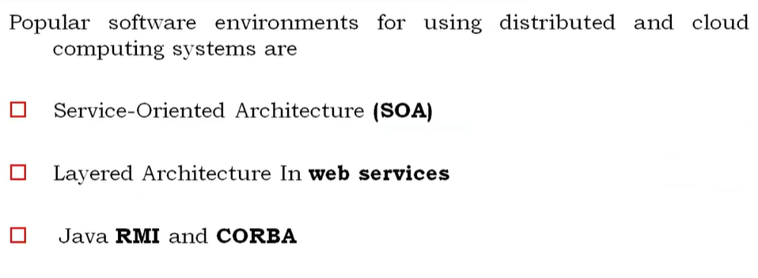
Software Environments for Distributed Systems and Clouds

Slide 43
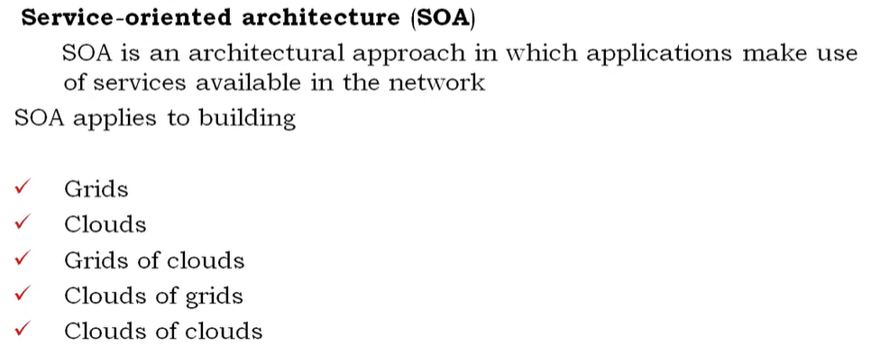

Slide 44
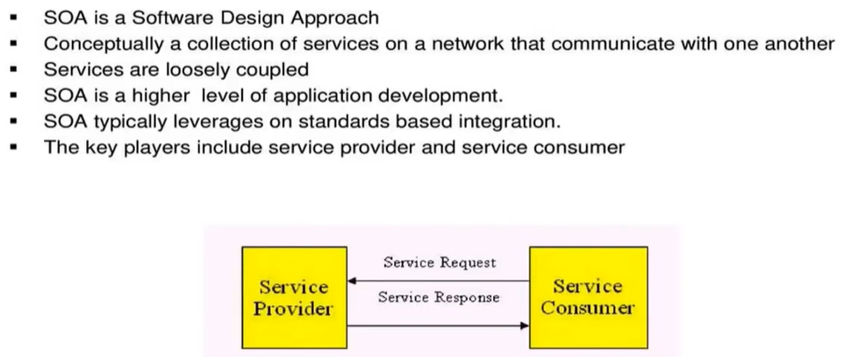
SOA

Slide 45
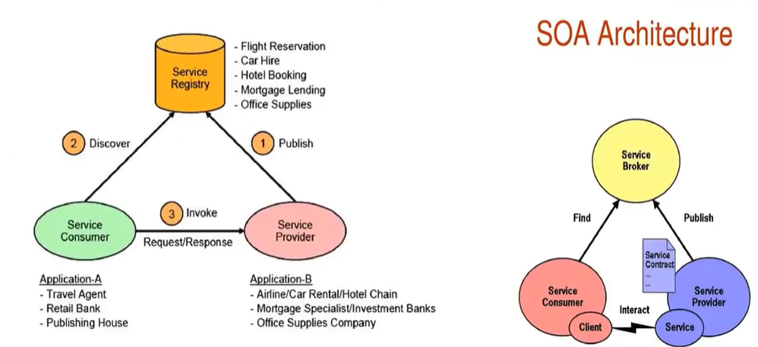
SOA Components and Operations

Slide 46
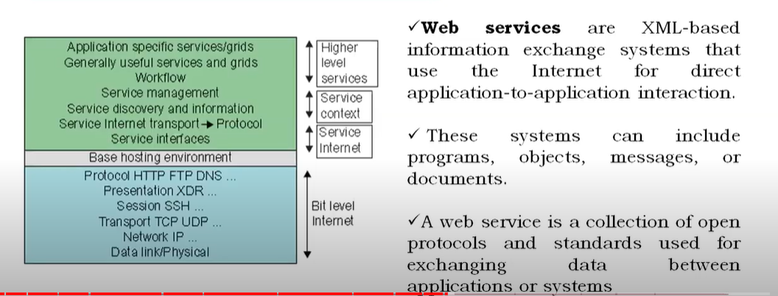
Layered Architectures in Web Services

Slide 47
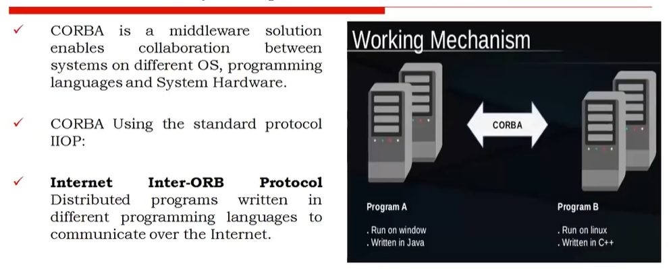
Common Object Request Broker Architecture (CORBA)

Slide 48
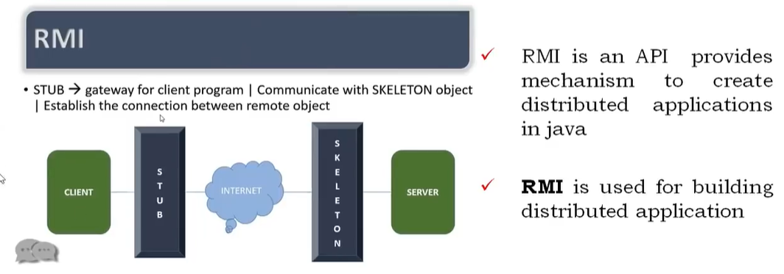
Remote Method Invocation (RMI)

Slide 49
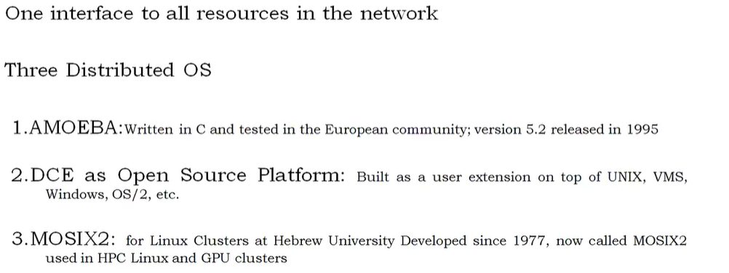
Trends towards distributed Operating systems

Slide 50
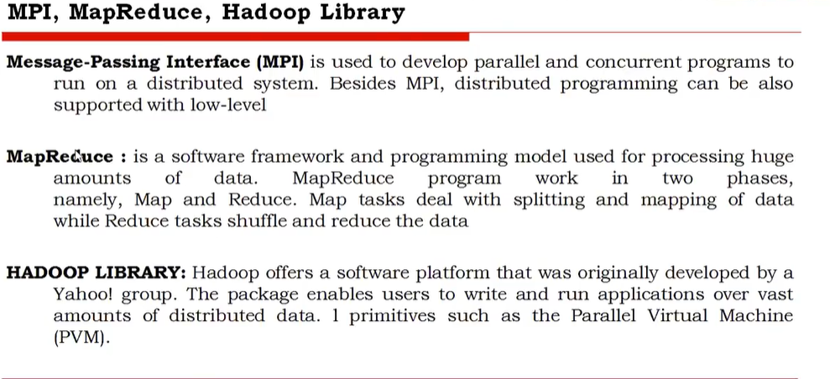
Parallel and Distributed Programming Models

